Slide 1
Music Genre Classification
Louis A. Gomez
Stevens Institute of Technology
Notes:
Introductions
Presenting this paper on behalf of -

Slide 2
This project
Software: Scikit Learn
ML Models: KNN, Random Forest
Evaluation: Precision, recall, and f1 score

Slide 3
Dataset
Data colleted from 9 popular spotify genre specific playlists
Four classes: Rap, Country, EDM, R&B
509 unique songs
12 audio specific features:
Class | Frequency
Country | 102
EDM | 158
Rap | 129
RnB | 120
Notes:
Features include: Tempo, valence, Speechiness, loudness, liveness, Instrumentalness, energy, danceability, Acousticness, mode, time signature, and key

Slide 4
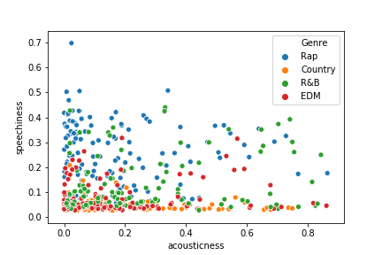
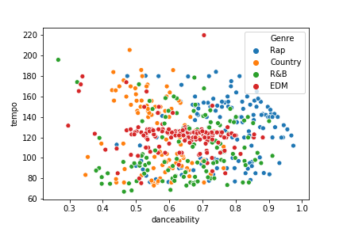
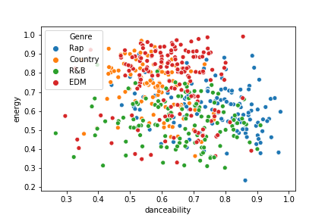
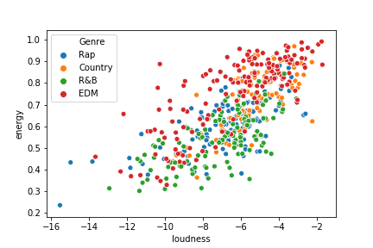

Slide 5
ML Modelling: KNN
Within genre similarity
Main hyperparameter is K
10-fold cross validation to get optimum value for K over a range of [1,30], K = 26,cv accuracy = 0.657

Slide 6
ML Modelling: Random Forest
Robust and able to form complex relationships between features
Randomized Grid Search and 10-fold cross validation due to large hyperparameter space
No. of Trees | 100
Max Depth | 5
Min sample split | 5
Min sample in leaf | 2
Rest | Default values

Slide 7
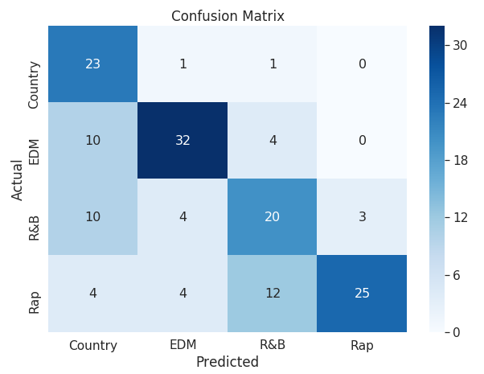
Results: KNN
KNN
 | Precision | Recall | F1 Score | No. in Test set
Country | 0.49 | 0.92 | 0.64 | 25
EDM | 0.78 | 0.70 | 0.74 | 46
RnB | 0.54 | 0.54 | 0.54 | 37
Rap | 0.89 | 0.56 | 0.68 | 45
KNN Overall Accuracy: 0.65
Notes:
What is precision, recall and f1 score
Using KNN on the test set and as shown in Table 1 , we achieved an overall average
accuracy of 0:65. Further examining the individual precision, recall and f1 scores, the highest
f1 score was seen in EDM class with 0:74. The highest recall was seen in the Country class
with 0:92 while the highest precision was seen in the Rap class with 0:89. Additionally, the
RnB Class had a low recall and precision of 0:54. This means that of all the 37 samples in
the test set labelled as RnB, it was accurate 54% of the time. On precision, the Country
class scored lowest with 0:49 which means that of all the test samples labelled as country,
only 49% of them were actually of the country class.
Random Forest Using Random Forest, we improve performance across the four classes.
We achieve higher precision, recall and f1 score in most of the genre classes as seen in Table
1 but we have marginal reductions in some. Notably our classication performance on the
RnB class is increased from 0:54 using KNN to 0:61 using random forest. Additionally, the
precision on the country class improved from 0:49 using KNN to 0:65. Our overall average
accuracy was 0:73. For feature importance, the top ve important features for the random
forest were: speechiness, energy, instrumentalness, danceability, and tempo.

Slide 8
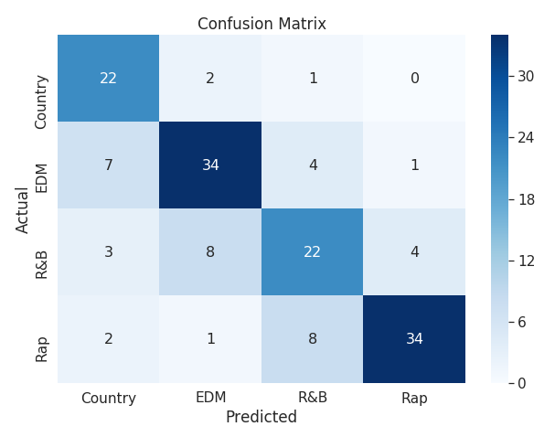
Results: Random Forest
Random Forest
 | Precision | Recall | F1 Score | No. in Test set
Country | 0.65 | 0.88 | 0.75 | 25
EDM | 0.76 | 0.74 | 0.75 | 46
RnB | 0.63 | 0.59 | 0.61 | 37
Rap | 0.87 | 0.76 | 0.81 | 45
Random Forest Overall Accuracy: 0.73
Notes:
What is precision, recall and f1 score
Using KNN on the test set and as shown in Table 1 , we achieved an overall average
accuracy of 0:65. Further examining the individual precision, recall and f1 scores, the highest
f1 score was seen in EDM class with 0:74. The highest recall was seen in the Country class
with 0:92 while the highest precision was seen in the Rap class with 0:89. Additionally, the
RnB Class had a low recall and precision of 0:54. This means that of all the 37 samples in
the test set labelled as RnB, it was accurate 54% of the time. On precision, the Country
class scored lowest with 0:49 which means that of all the test samples labelled as country,
only 49% of them were actually of the country class.
Random Forest Using Random Forest, we improve performance across the four classes.
We achieve higher precision, recall and f1 score in most of the genre classes as seen in Table
1 but we have marginal reductions in some. Notably our classication performance on the
RnB class is increased from 0:54 using KNN to 0:61 using random forest. Additionally, the
precision on the country class improved from 0:49 using KNN to 0:65. Our overall average
accuracy was 0:73. For feature importance, the top ve important features for the random
forest were: speechiness, energy, instrumentalness, danceability, and tempo.

Slide 9
Results: Summary
 | KNN |  |  |  | Random Forest
 | Precision | Recall | F1 Score |  | Precision | Recall | F1 Score | No. in Test set
Country | 0.49 | 0.92 | 0.64 |  | 0.65 | 0.88 | 0.75 | 25
EDM | 0.78 | 0.70 | 0.74 |  | 0.76 | 0.74 | 0.75 | 46
RnB | 0.54 | 0.54 | 0.54 |  | 0.63 | 0.59 | 0.61 | 37
Rap | 0.89 | 0.56 | 0.68 |  | 0.87 | 0.76 | 0.81 | 45
KNN Overall Accuracy: 0.65 |  |  |  | RF Overall Accuracy: 0.73
Overall, Random Forest had a better class level accuracy and overall accuracy
Notes:
What is precision, recall and f1 score
Using KNN on the test set and as shown in Table 1 , we achieved an overall average
accuracy of 0:65. Further examining the individual precision, recall and f1 scores, the highest
f1 score was seen in EDM class with 0:74. The highest recall was seen in the Country class
with 0:92 while the highest precision was seen in the Rap class with 0:89. Additionally, the
RnB Class had a low recall and precision of 0:54. This means that of all the 37 samples in
the test set labelled as RnB, it was accurate 54% of the time. On precision, the Country
class scored lowest with 0:49 which means that of all the test samples labelled as country,
only 49% of them were actually of the country class.
Random Forest Using Random Forest, we improve performance across the four classes.
We achieve higher precision, recall and f1 score in most of the genre classes as seen in Table
1 but we have marginal reductions in some. Notably our classication performance on the
RnB class is increased from 0:54 using KNN to 0:61 using random forest. Additionally, the
precision on the country class improved from 0:49 using KNN to 0:65. Our overall average
accuracy was 0:73. For feature importance, the top ve important features for the random
forest were: speechiness, energy, instrumentalness, danceability, and tempo.

Slide 10
Conclusions
It is feasible to predict the genre of a song given a common set of features
Using a simple KNN model, we achieve an overall accuracy of 65% while with a Random Forest, we achieve 73% accuracy on the same task.
For future work, it would be advantageous to investigate the misclassified songs per genre to understand why they were wrong.
Notes:
In summary, we have shown that is feasible to predict the genre of music given a common
set of features. Using our simple model KNN we achieved an overall accuracy of 0:65. Using
a more advanced method such as Random forest improves this accuracy to 0:73. For future
work, it be advantageous to investigate the misclassied songs and see why they were said
to be of specic genres.

Slide 11
Questions?

